Slide 1
Introduction to Machine Learning
Jupyter Notebook found at
https://github.com/JeffreyCHChan/JeffreyCHChan

Slide 2
Goal
Short Intro to Python
Provide an understanding of Machine Learning vs Artificial Intelligence
Present common Python ML & Deep Learning libraries
Typical pipeline
Sample of code with comment explanation
  requirements.txt
Notes:
Gauge the skill level on programming knowledge of room

Slide 3
What will not be covered
Generative Artificial Intelligence/Large Language models
  Leila Kosseim (I took her for COMP 472 - Artificial Intelligence)
    Added topics to outline for Fall 2023
Deep understanding of the math

Slide 4
Fundamentals of Python
Intro to Python.ipynb
(Python 3.10.10 will be used)

Slide 5
Python Overview - 1
Commenting can be done using
  # comment
    Comment only applies to the text in the same line as the # symbol
  ‘’’ comment ‘’’
    Multi line comment
Data Types:
  Boolean
    Values:
      True; False
    Operations:
      Or; and, not
  Numeric
    Operations:
      x/y → division
      x//y → floored division
      x%y → remainder
  Text
    Strings are immutable meaning these lines of code will cause a TypeError
    string = 'Hi'
string[0] = "p"
    How it can be done is
    string = 'Hi'
    string = "p"+ string[1] # note that you can access the value of a string subset using square brackets

Slide 6
Python Overview - 2
Collections
  Dictionaries → collection denoted by curly brackets {}
    No need to define size before assignment
    Syntax:
      var_name = {}
    Index are unique keys that are associated with any values
  Arrays → collection denoted by square brackets []
    No need to define size before assignment
    Syntax:
      var_name = []
    Index starts at 0; ordered collection
    Accessing elements is done using the list’s name followed by square brackets
      Var_name[0] # first element
  Sets can be achieved using the set() method on a list []
  OR
  using {} like this
    odds: set = {1, 3, 5, 7 , 9}
return something
File I/O
  Two ways:
    with open("hello.txt") as my_file:
print(my_file.read())
    my_file = open("hello.txt")
print(my_file.read())
my_file.close()
Notes:
Arrays unlike other languages do not require setting the size and therefore you can append to them for as much as you want.
File I/O when working outside of a library like Pandas which I will touch on later, being able to read and write to a file using one of these options is important.

Slide 7
Python Overview - 3
Functions:
  def functionName(parameter, default_paramter=presetValue):
# code block
return something
Note that parameters do not need to be defined and this is also valid
  def functionName():
# code block
Classes:
  class Test:
def __init__(self, x) -> None: # constructor
self.x = x # can anyone tell me how the x is used here?
def functionName(parameter, default_paramter=presetValue):
# code block
return something
  No need for getters and setters as attributes can be accessed directly as
  most attributes and functions are public
Control Flow:
  if [condition]:, elif [condition]:, else:
    Replace [condition] with the variables you plan to use.
  “Switch” case is called “match” case
Notes:
Note that here __init__() uses → this is another way to denote what is being returned after the function is called

Slide 8
Python Intricacies
Unlike other programming languages such as C, C++, C#, Java, etc.
  Python does NOT use semicolons but uses spacing so the number of tabs used is super important. A single space may make valid code not execute.
Ways to import/use a library/module
  import pickle # this results in the whole library becoming available at the cost of memory.
  from sklearn import preprocessing # this imports a specific sub-library or method to be used
  import pandas as pd # this imports a library using an alias which is useful for long names
Official Python Tutorial (Link)

Slide 9
Last notes on Python
Check the official Python documentation for useful built-in modules/libraries.
  https://docs.python.org/3/py-modindex.html
  Useful ones to be aware of:
    Queue
      LIFO, FIFO, Priority
    Unittest
    Tkinter
    re
    pickle
    math
    Asynchio
Recently added in Python 3.12: Type Hints

Slide 10
Machine Learning
Machine Learning Demo.ipynb
Notes:
Gauge the skill level on ML of the room
Ask if anyone can describe the difference between AI and ML

Slide 11
Machine Learning vs Artificial Intelligence
Machine Learning is a subset field within Artificial Intelligence.
  Machine learning typically uses large volumes of data that models use to optimize parameters
    Linear Regression (supervised), Clustering (unsupervised), Neural Networks, etc.
  Artificial Intelligence aims to have computers/models solve problems using machine learning models, search algorithms (heuristics), deep learning models
    Real life example: Card counting, path searching, solving puzzles, etc.
How does Deep Learning fit into all of this?
  Deep Learning is a subset of machine learning which uses deep (many hidden layers) neural networks to answer problems using large datasets.
  Common structures:
    Recurrent Neural Network (RNN)
    Convolutional Networks (CNN)
    Recursive Neural Networks (RNN vs. Recurrent)
    …

Slide 12
Common Data Categories
You Will Encounter
Categorical:
  Red, Green, Blue; Dog, Cat, Human; etc.
  Note: LabelEncoder in scikit-learn is an option
Ordinal:
  First, Second, Third; 1,2,3; etc.
  Note: OrdinalEncoder in scikit-learn is an option
Numerical:
  1, 2.000

Slide 13
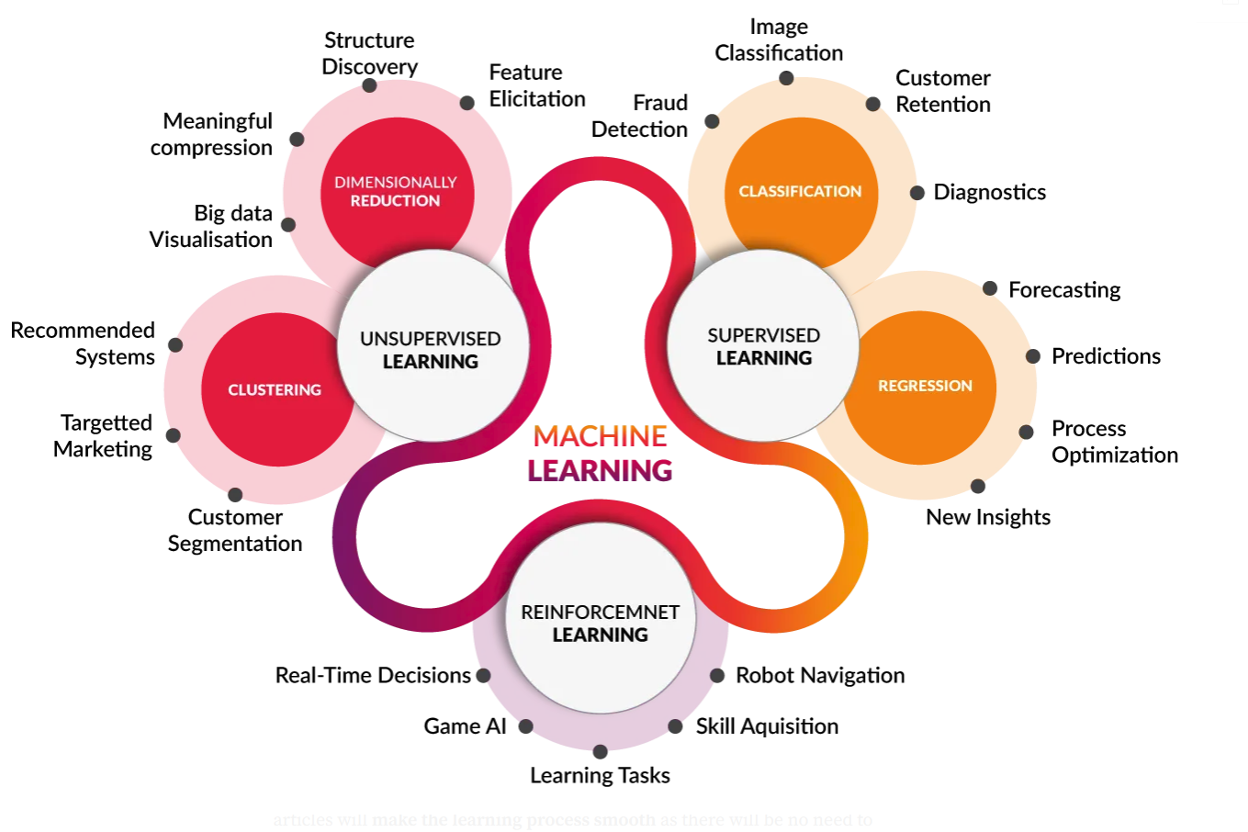
Categories of Machine Learning
Supervised
  Features known
  Labelled data/ “expected answer”
Unsupervised
  Features known
  Unlabelled data/ no “expected answer”
Reinforcement Learning
  Give a model or agent a task then reward or punish based on the result.
https://www.analyticsvidhya.com/blog/2021/03/kickstart-guide-to-become-a-m-a-d-programmer/
Notes:
Example of supervised learning is shopping data where that use case can be explored as a classification problem or a regression problem and I’ll talk about that in the next slide.

Slide 14
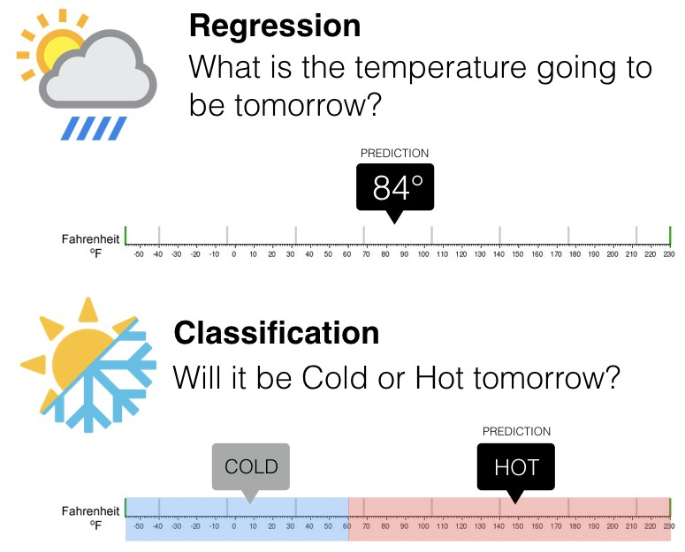
Regression vs Classification
Generally
  Regression usually will predict continuous numerical values
  Classification aims to predict class/grouping or discrete values

Slide 15
Common Libraries
Models:
  Scikit-learn (Machine Learning) Today’s focus
  TensorFlow (Deep Learning)
  PyTorch (Deep Learning)
Covered Briefly
  Data Prep and Cleaning
    NumPy (arrays)
    Pandas (DataFrames)
  Optimization/Data Leaking
    Cross Validation (Link)
    Hyperparameter Search (Link)

Slide 16
NumPy & Pandas
NumPy
  Used for numerical computing to provide efficient array operations and mathematical functions for scientific applications
  SciPy is an alternative that offers more features such as system optimization
  Provides easier manipulation of multi-dimensional arrays
Pandas
  Data manipulation library for working with structured data.
    Structured: the data columns are consistent (like a table)
  Common Analogy is an Excel sheet
  Built on NumPy
  Used for data cleaning and data manipulation before applying models.
Notes:
NumPy you can think of “arrays” within arrays within arrays. When I think of linear algebra and working with matrices I would opt for NumPy or SciPy.
Pandas is more like a spreadsheet where the axis are pretty well defined in the sense that adding, removing, manipulating data is done column by column or row by row

Slide 17
Crash Course on Pandas - 1
https://pandas.pydata.org/Pandas_Cheat_Sheet.pdf
Ingest data
  Pd.read_{file type} (Link)
Peaking into a DataFrame (assume we created a DataFrame named df)
  df.head()
  df.tail()
  df.describe()
Handling Missing Data
  df.dropna() #Drop rows with any column having NA/null data.
  df.fillna(value) #Replace all NA/null data with value.

Slide 18
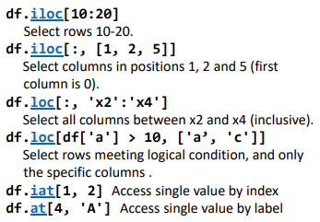
Crash Course on Pandas - 2
Selecting columns and rows
  df[df.Length > 7] # Extract rows that meet logical criteria.
  df[['width’, 'length’, 'species']] # Select multiple columns with specific names.
  df.loc[] and df.iloc[] # to select only rows, only columns or both.
  Use df.at[] and df.iat[] to access a single value by row and column.

Slide 19
General Machine Learning Flow
Data Gathering (I have done this part for you)
  Kaggle.com
  Concordia Open Data
  Canada Open Data
Data Splitting
  Usually 80% training and 20% testing
    Test data will have the label/expected answer removed as the model will try to predict it.
    Note: you can further split the training data 80% and 20% for training and validation respectively
Data Preparation & Cleaning
Model Training
  For reproducibility many ML libraries allow for seeding /random_state via a parameter.
Model Evaluation/Cross Validation
Model Refinement (If you get a perfect model without this… check again)

Slide 20
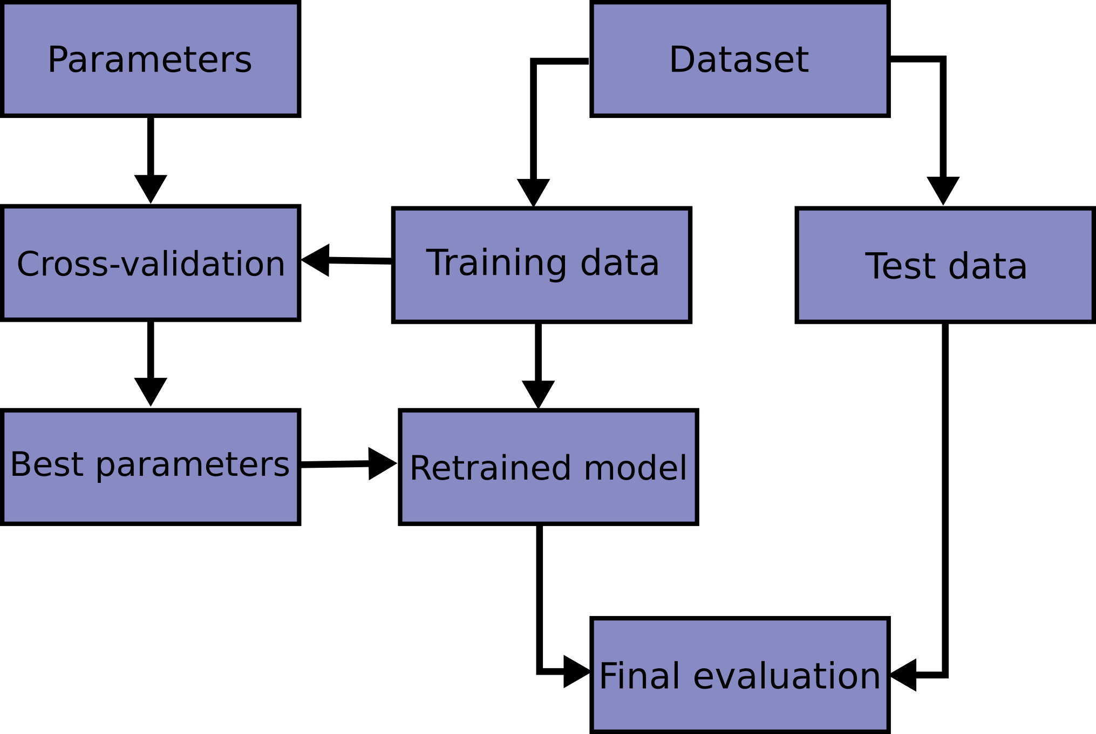
Machine Learning Workflow

Slide 21
Metrics
When training and testing the models we must optimize (max or min) something!
Accuracy: (TP+TN)/(TP+TN+FP+FN) not the best metric
  % of instances of the test set the algorithm correctly classifies
  Viable if all classes are equally important AND represented
Precision: TP/(TP+FP)
  How many in the guesses were correct?
Recall: TP/(TP+FN)
  How many of the right answers did I get from everything?
F1 score: (2*Precision * Recall)/(Precision + Recall); equal weighting
  ((B²+1)*Precision * Recall)/(B²*Precision + Recall)
    B>1 puts more weight on Recall
There are many more but these are the first ones you should know after accuracy!

Slide 22
Common Mistakes
Data Prep
  Filling Nan values by taking averages of the entire dataset BEFORE train/test split.
    This allows for data leaks where the test data is able to infer information/answers from the training split.
  Forgetting to encode text data into numerical values.
    Label Encoder (Link)
    Text data can be encoded in many ways such as One Hot Encoding.
Training/Testing
  Picking a complex model when a simple model performs just as well!
    KISS principle
  Overfitting:
    Low Training Error and High Testing Error
    “Memorized” the answers so it generalizes poorly
  Underfitting:
    High Training Error and High Testing Error
    Model did not learn enough to make correct predictions

Slide 23
Concordia Data Courses
SOEN 471 - Big Data Analytics
  Tristan Glatard
COMP 472 - Artificial Intelligence
  Leila Kosseim
COMP 432 - Machine Learning
  Mirco Ravanelli
COMP 433 - Deep Learning
  Did not count for credits for SOEN when I was here.
COMP 333 - Data Analytics

Slide 24
My Setup
Python3
  I use 3.10.10
Code Editor
  Visual Studio Code is a flexible Code Editor that you can customize as you need
  PyCharm has a community version, being a student you should have access to GitHub Student Pack which provides you with a JetBrains license
Jupyter Notebook
  Allows code to be run in chunks which makes it easier to view results as you go.
Really that’s all you really need! If you are interested in deep learning a GPU may be helpful.

Slide 25
DEMO
Notes:
My goal is here that you leave today with a ground level understanding of ML.

Slide 26
DEMO
Things you might want to tune:
  Hyper parameters
    Also called “Attributes” within the scikit-learn documentation
  Included Features (I removed “Name” from the feature list)
Note:
  Classification_report/confusion matrix is the visualization where the diagonal is the correct predictions
Supervised Learning Models Used:
  Multinomial Naive Bayes
    1) Given the conditional probabilities of these features occurring what is the probability this result/label/group occurs. Repeat for all possible result/label/group.
    2) Select the result/label/group that has the highest probability as the prediction!
  Decision Tree
    At each node I have to make a decision/choice that will split the data into chunks.
    How we determine the best feature to split the data on is typically determined using entropy or gini with the aim to minimize the “chaos” or maximize information gain.
  Multi-Layer Perceptron (very simple neural network)
    1) Pass (numeric) data point forward through nodes (n) that connect to the next layer of nodes (n+1) with weights (w) this happens until you reach the final layer that provides an output.
      All nodes that are not input nodes will use the sum of weight * input as parameters of an activation function (sigmoid, Logistic, ReLu, etc.).
    2.1) If the prediction is correct then proceed to next data point.
    2.2) If the weights need to be updated, fix weights starting from the output node to the input nodes

Slide 27
Hyper Parameters
Near the end of the notebook you will find GridSearchCV being used, this is a method to do hyperparameter search.
Most models do not optimally work using the default “settings”.
Hyper Parameters are the knobs of a model we can fine tune to get more performance.

Slide 28
Advanced/Relevant Topics
(Not Covered Today)
Ensemble Models:
  Making use of multiple models into a “single” model
    Bagging: several estimators independently and then to average their predictions.
      Ex: Random Forest (based on Decision Trees)
    Boosting: base estimators are built sequentially and one tries to reduce the bias of the combined estimator. The motivation is to combine several weak models to produce a powerful ensemble.
      AdaBoost (using sequential series of “weak” estimators)
Natural Language Processing (NLP)
  Mixture of Artificial Intelligence and Machine Learning
Heuristics
  More Artificial Intelligence

Slide 29
Interesting Tools/Libraries
PySpark
  How can we distribute work in machine learning and data engineering.
spaCy
  Natural Language Processing (NLP)
fastf1
  This is an API that archives data from Formula 1 races
PyTorch
  Deep learning library created by Meta
TensorFlow
  Deep learning library created by Google

Slide 30
Key Takeaways
Garbage data into a model leads to garbage models!
Complex models are not always the best!
It is an iterative design and validation process!

Slide 31
Data Sets Commonly Used In Demos
Titanic
Iris
MNIST dataset (handwritten data)
https://scikit-learn.org/stable/modules/classes.html#module-sklearn.datasets

Slide 32
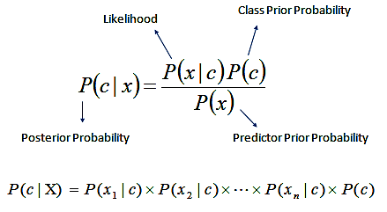
Naive Bayes
What is the probability of c happening given that x happened.
Note: The simplification of this multiplies the P(x) since it is the same for all c.
How does it determine conclusion?
  Take the argMax or the highest value of the possible conclusions.
https://uc-r.github.io/naive_bayes

Slide 33
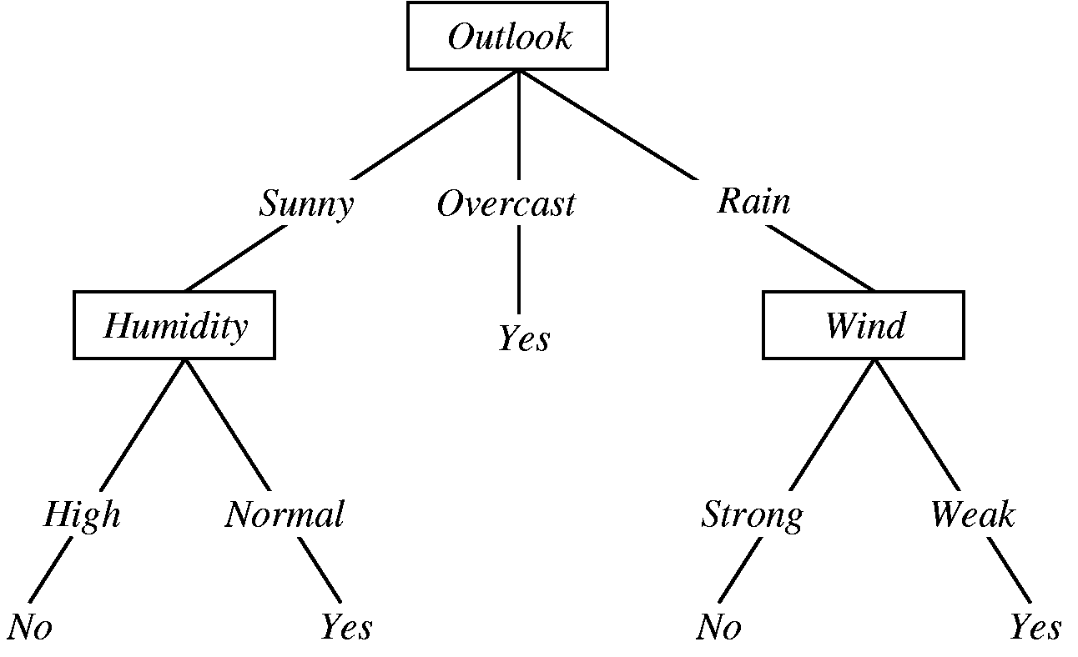


Decision Trees
Let’s split the data using a feature to minimize the chaos!
The goal is to have features to determine classes
Typical metric to use is gini, entropy.
Great if you want to explain/visualize how a model determined its conclusion.
Entropy
https://towardsdatascience.com/decision-tree-in-machine-learning-e380942a4c96

Slide 34
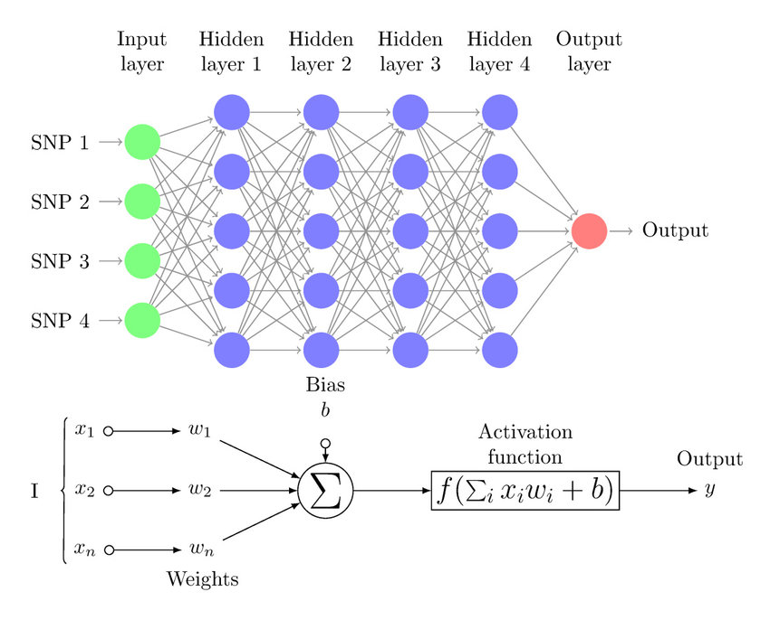
Multi Layered Perceptron
A single perceptron can be viewed like this:
  1) Taking the sum of weighted inputs plus any weights
  2) Apply that value to an activation function then pass that as an output.
  3) Go to Step 1 unless there is not another perceptron to go to
  4) Does the final output match the expected?
    Yes: move onto next data point!
    No: Fix the weights through backpropagation
      Backpropagation
      TL:DR if the if the expected value is higher
      weights should be more positive!
Deep Learning Neural Networks come from many
hidden layers.
https://www.researchgate.net/figure/Multi-Layer-Perceptron-MLP-diagram-with-four-hidden-layers-and-a-collection-of-single_fig1_334609713

Slide 35

Contact
LinkedIn: Jeffrey C.H. Chan
GitHub: https://github.com/JeffreyCHChan

Slide 36
Q&A

Slide 37
Resources
https://scikit-learn.org/stable/index.html
https://pytorch.org/
https://pandas.pydata.org/docs/index.html
https://pythonprogramming.net/
https://numpy.org/

